Slide 1

Spreadsheet Modeling
& Decision Analysis
A Practical Introduction to Business Analytics
8th edition
Cliff T. Ragsdale

Slide 2
Introduction to Simulation
Using Analytic Solver Platform
Chapter 12

Slide 3
On Uncertainty and Decision-Making…
"Uncertainty is the most difficult thing about decision-making. In the face of uncertainty, some people react with paralysis, or they do exhaustive research to avoid making a decision. The best decision-making happens when the mental environment is focused. …That fined-tuned focus doesn’t leave room for fears and doubts to enter. Doubts knock at the door of our consciousness, but you don't have to have them in for tea and crumpets."
-- Timothy Gallwey, author of The Inner Game of Tennis and The Inner Game of Work.

Slide 4
Introduction to Simulation
In many spreadsheets, the value for one or more cells representing independent variables is unknown or uncertain.
As a result, there is uncertainty about the value the dependent variable will assume:
  Y = f(X₁, X₂, …, X_{k})
Simulation can be used to analyze these types of models.

Slide 5
Random Variables & Risk
A random variable is any variable whose value cannot be predicted or set with certainty.
Many “input cells” in spreadsheet models are actually random variables.
  the future cost of raw materials
  future interest rates
  future number of employees in a firm
  expected product demand
Decisions made on the basis of uncertain information often involve risk.
“Risk” implies the potential for loss.

Slide 6
Why Use Simulation to Analyze Risk?
Using “expected values” for uncertain independent (X) variables may give us the wrong “expected value” for the dependent (Y) variable…
Y
E(Y) ??
E(X)
X
In this case, the expected value of Y should
be something less than its maximum value.

Slide 7
Why Use Simulation to Analyze Risk?
Plugging in expected values for uncertain cells tells us nothing about the variability of the performance measure we base decisions on…
  Suppose an $1,000 investment is expected to return $10,000 in two years. Would you invest if...
  the outcomes could range from $9,000 to $11,000?
  the outcomes could range from -$30,000 to $50,000?
  Alternatives with the same expected value may involve different levels of risk.

Slide 8
Methods of Risk Analysis
Best-Case/Worst-Case Analysis
What-if Analysis
Simulation

Slide 9
Best-Case/Worst-Case Analysis
Best case - plug in the most optimistic values for each of the uncertain cells.
Worst case - plug in the most pessimistic values for each of the uncertain cells.
This is easy to do but tells us nothing about the distribution of possible outcomes within the best and worst-case limits.

Slide 10
Possible Performance Measure Distributions Within a Range
worst case
best case
worst case
best case
worst case
best case
worst case
best case

Slide 11
What-If Analysis
Plug in different values for the uncertain cells and see what happens.
This is easy to do with spreadsheets.
Problems:
  Values may be chosen in a biased way.
  Hundreds or thousands of scenarios may be required to generate a representative distribution.
  Does not supply the tangible evidence (facts and figures) needed to justify decisions to management.

Slide 12
Simulation
Resembles automated what-if analysis.
Values for uncertain cells are selected in an unbiased manner.
The computer generates hundreds (or thousands) of scenarios.
We analyze the results of these scenarios to better understand the behavior of the performance measure.
This allows us to make decisions using solid empirical evidence.

Slide 13
Example: Hungry Dawg Restaurants
Hungry Dawg is a growing restaurant chain with a self-insured employee health plan.
Covered employees contribute $125 per month to the plan, Hungry Dawg pays the rest.
The number of covered employees changes from month to month.
The number of covered employees was 18,533 last month and this is expected to increase by 2% per month.
The average claim per employee was $250 last month and is expected to increase at a rate of 1% per month.

Slide 14
Implementing the Model
See file Fig12-2.xlsm

Slide 15
Questions About the Model
Will the number of covered employees really increase by exactly 2% each month?
Will the average health claim per employee really increase by exactly 1% each month?
How likely is it that the total company cost will be exactly $36,125,850 in the coming year?
What is the probability that the total company cost will exceed, say, $38,000,000?

Slide 16
Simulation
To properly assess the risk inherent in the model we need to use simulation.
Simulation is a 4-step process:
  1) Identify the uncertain cells in the model.
  2) Implement appropriate RNGs for each uncertain cell.
  3) Replicate the model n times and record the value of the bottom-line performance measure.
  4) Analyze the sample values collected on the performance measure.

Slide 17
What is Analytic Solver Platform?
Analytic Solver Platform (ASP) is a spreadsheet add-in that simplifies spreadsheet simulation.
ASP provides:
  dialogs & functions for generating random numbers
  commands for running simulations
  graphical & statistical summaries of simulation data
For more info see:http://www.solver.com

Slide 18
Random Number Generators (RNGs)
A RNG is a mathematical function that randomly generates (returns) a value from a particular probability distribution.
We can implement RNGs for uncertain cells to allow us to sample from the distribution of values expected for different cells.

Slide 19
How RNGs Work
The RAND( ) function returns uniformly distributed random numbers between 0.0 and 0.9999999.
Suppose we want to simulate the act of tossing a fair coin.
Let 1 represent “heads” and 2 represent “tails”.
Consider the following RNG:
  =IF(RAND( )<0.5,1,2)

Slide 20
Simulating the Roll of a Die
We want the values 1, 2, 3, 4, 5 & 6 to occur randomly with equal probability of occurrence.
Consider the following RNG:
  =INT(6*RAND())+1
If 6*RAND( ) falls INT(6*RAND( ))+1
in the interval: returns the value:
0.0 to 0.999 1
1.0 to 1.999 2
2.0 to 2.999 3
3.0 to 3.999 4
4.0 to 4.999 5
5.0 to 5.999 6

Slide 21
Generating Random Numbers
With Analytic Solver Platform
ASP uses “Psi” functions to implement RNGs in spreadsheets
  “Psi” functions
    Used in formulas like any other Excel function
    Require ASP to be installed on the machine displaying the spreadsheet
  The Distribution Gallery
    Displays graphical depictions of RNG distributions to assist in selecting the appropriate Psi function

Slide 22
Some of the RNGs Provided
By Analytic Solver Platform
Distribution RNG Function
Binomial PsiBinomial(n,p)
Chi-Square PsiChisquare(λ)
Poisson PsiPoisson(λ)
Continuous Uniform PsiUniform(min,max)
Exponential PsiExponential(λ)
Triangular PsiTriang(min, most likely, max)
Normal PsiNormal(μ,σ)
Truncated Normal PsiNormal(μ,σ, PsiTruncate(min,max))
(And there are many others)

Slide 23
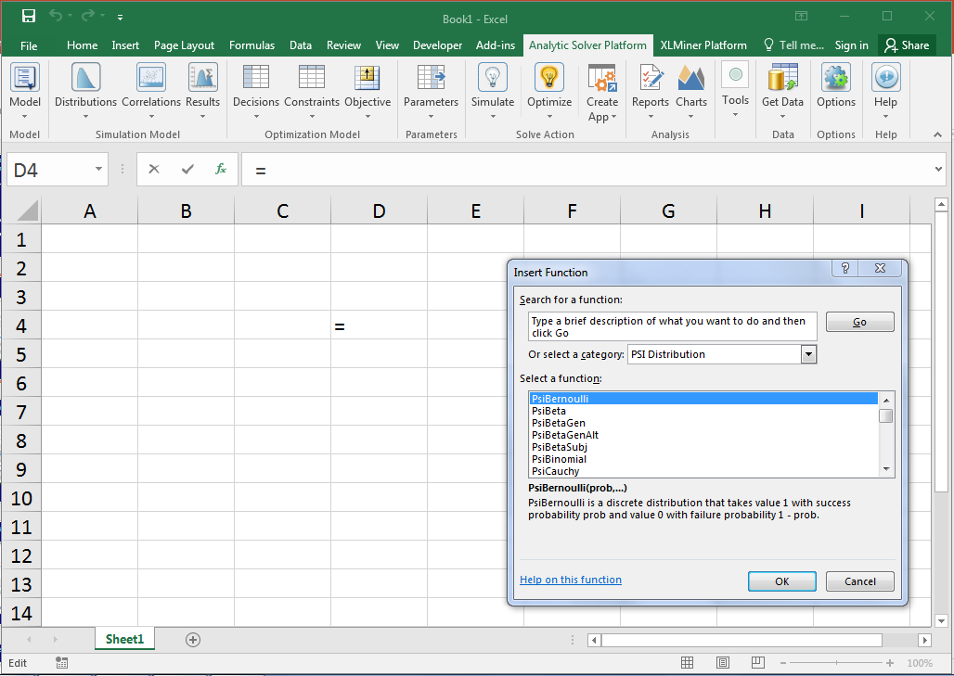
Using Psi Functions
Click Insert Function icon
Select Psi
distribution
Select Psi
function

Slide 24
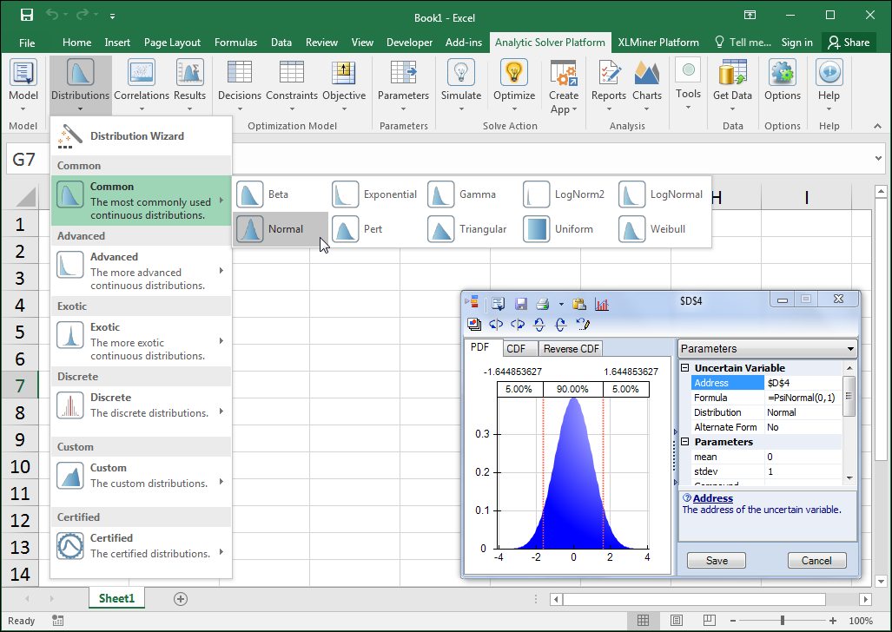
Using the Distribution Gallery
1. Click Distributions
2. Select distribution
3. Specify parameters
4. Click Save

Slide 25
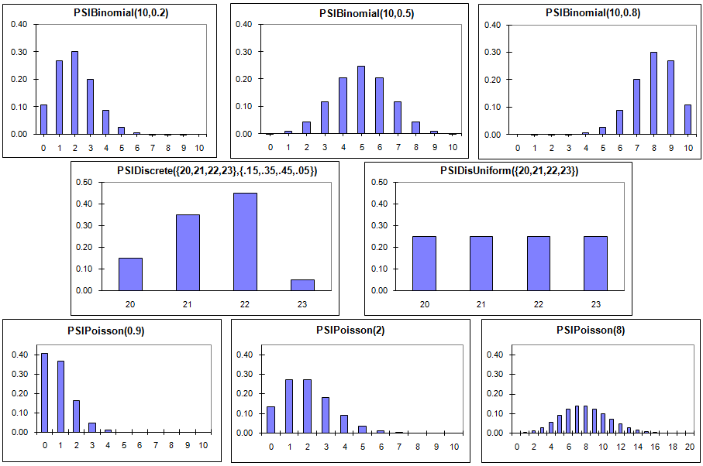
Examples of Discrete Probability Distributions

Slide 26
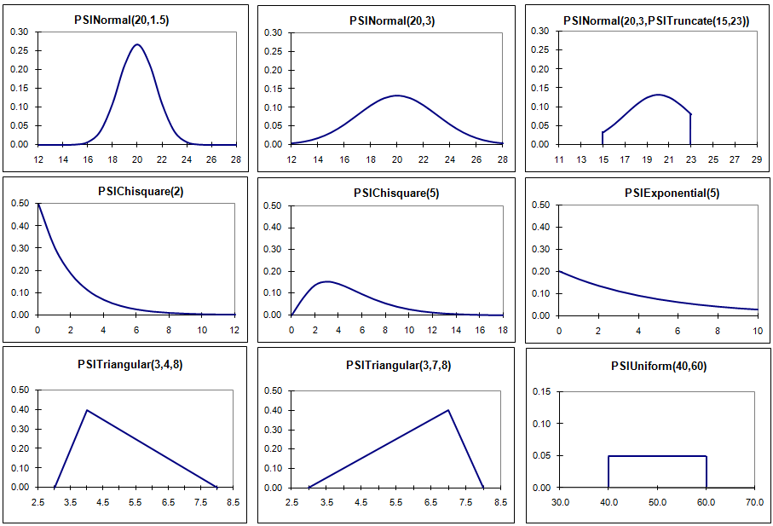
Examples of Continuous Probability Distributions

Slide 27
Discrete vs. Continuous
Random Variables
A discrete random variable may assume one of a fixed set of (usually integer) values.
  Example: The number of defective tires on a new car can be 0, 1, 2, 3, or 4.
A continuous random variable may assume one of an infinite number of values in a specified range.
  Example: The amount of gasoline in a new car can be any value between 0 and the maximum capacity of the fuel tank.

Slide 28
Preparing the Model for Simulation
Suppose we analyzed historical data and found that:
  The change in the number of covered employees each month is uniformly distributed between a 3% decrease and a 7% increase.
  The average claim per employee follows a normal distribution with mean increasing by 1% per month and a standard deviation of $3.

Slide 29
Revising & Simulating the Model
See file Fig12-6.xlsm

Slide 30
Psi Functions for Analyzing
PsiOutput( ) Cells
Psi Function Meaning
PsiMax(x) Returns maximum of output cell x
PsiMin(x) Returns minimum of output cell x
PsiMean(x) Returns mean of output cell x
PsiStdDev(x) Returns std dev of output cell x
PsiPercentile(x, y) Returns y^{th} percentile of output cell x
PsiTarget(x,y) Returns P( x < y)
(And there are many others)

Slide 31
The Uncertainty of Sampling
The replications of our model represent a sample from the (infinite) population of all possible replications.
Suppose we repeated the simulation and obtained a new sample of the same size.
  Q: Would the statistical results be the same?
  A: No!
As the sample size (# of replications) increases, the sample statistics converge to the true population values.
We can also construct confidence intervals for a number of statistics...

Slide 32
Constructing a Confidence Interval for the True Population Mean
where:
Note that as n increases, the width of the confidence interval decreases.

Slide 33
Constructing a Confidence Interval for the True Population Proportion
where:
Note again that as n increases, the width of the confidence interval decreases.

Slide 34
Additional Uses of Simulation
Simulation is used to describe the behavior, distribution and/or characteristics of some bottom-line performance measure when values of one or more input variables are uncertain.
Often, some input variables are under the decision maker's control.
We can use simulation to assist in finding the values of the controllable variables that cause the system to operate optimally.
The following examples illustrate this process.

Slide 35
A Reservation Management Example:
Piedmont Commuter Airlines
PCA Flight 343 flies between a small regional airport and a major hub.
The plane has 19 seats & several are often vacant.
Tickets cost $150 non-refundable per seat.
There is a 0.10 probability of a sold seat being vacant.
If PCA overbooks, it must pay an average of $325 for any passengers that get “bumped”.
Demand for seats is random, as follows:
What is the optimal number of seats to sell?
Demand 14 15 16 17 18 19 20 21 22 23 24 25
Probability .03 .05 .07 .09 .11 .15 .18 .14 .08 .05 .03 .02

Slide 36
Random Number Seeds
RNGs can be “seeded” with an initial value that causes the same series of “random” numbers to generated repeatedly.
This is very useful when searching for the optimal value of a controllable parameter in a simulation model (e.g., # of seats to sell).
By using the same seed, the same exact scenarios can be used when evaluating different values for the controllable parameter.
Differences in the simulation results then solely reflect the differences in the controllable parameter – not random variation in the scenarios used.

Slide 37
Implementing & Simulating the Model
See file Fig12-18.xlsm

Slide 38
Inventory Control Example:
Millennium Computer Corporation (MCC)
MCC is a retail computer store facing fierce competition.
Stock outs are occurring on a popular monitor.
The current reorder point (ROP) is 28.
The current order size is 50.
Daily demand and order lead times vary randomly, viz.:
Units Demanded: 0 1 2 3 4 5 6 7 8 9 10
Probability: 0.01 0.02 0.04 0.06 0.09 0.14 0.18 0.22 0.16 0.06 0.02
Lead Time (days): 3 4 5
Probability: 0.2 0.6 0.2
MCC’s owner wants to determine the ROP and order size that will provide a 98% service level while minimizing average inventory.

Slide 39
Implementing & Simulating the Model
See file Fig12-23.xlsm

Slide 40
Optimizing the Model
See file Fig12-27.xlsm

Slide 41
A Project Selection Example:
TRC Technologies
TRC has $2 million to invest in the following new R&D projects.
Revenue Potential
Initial Cost Prob. Of ($1,000s)
Project ($1,000s) Success Min Likely Max
1 $250 0.9 $600 $750 $900
2 $650 0.7 $1250 $1500 $1600
3 $250 0.6 $500 $600 $750
4 $500 0.4 $1600 $1800 $1900
5 $700 0.8 $1150 $1200 $1400
6 $30 0.6 $150 $180 $250
7 $350 0.7 $750 $900 $1000
8 $70 0.9 $220 $250 $320
TRC wants to select the projects that will maximize the firm’s expected profit.

Slide 42
Implementing & Simulating the Model
See file Fig12-39.xlsm

Slide 43
End of Chapter 12

Slide 44

The Analytic Solver Platform software featured in this book is provided by Frontline Systems. http://www.solver.com

